Slide 1
Unity Tutorial Video Assignment
Game 330
Dahye Chung

Slide 2
Scriptable Object
Scriptable Object is a “Data Container” for large amount of data independent of class instance.
Zombies : Scriptable Object
Foods : Scriptable Object
Zombie Type
Tomato
Appearance
Apple
Run Speed
Grape
Hp
Cabbage
Ability
Meat
Notes:
What is a Scriptable Object?: A Scriptable Object is a class in Unity designed for storing data. It's useful for things like game settings, item attributes, and character stats.
Why Use Scriptable Objects?: They help reduce code duplication and make data management easier. For example, if multiple characters share the same stats, you can manage those stats in one place.

Slide 3
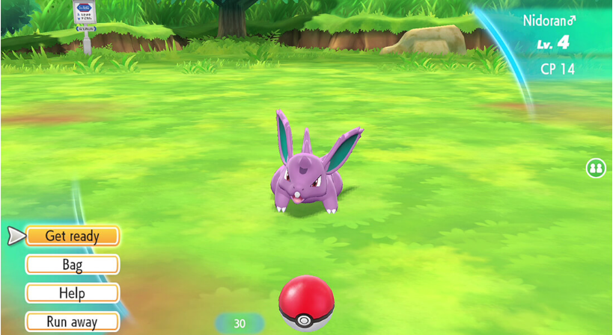
Why you need it?
Pokemon
Pokemon
Pokemon
Pokemon
Pokemon
Pokemon
Pokemon
Pokemon
Name | Pikachu | Charmander | Squirtle | etc
Type | Electric | Fire | Water | …
Prefab | Pikachu prefab | Charmander prefab | Squirtle Prefab | …
Hp | 30 | 40 | 20 | …
Speed | 6 | 5 | 4 | …
Notes:
This is one of the examples that most commonly used. Enemy stats.
If you have a bunch of pokemons that has different look, but they share the same pokemon type, skills.
You could have work on a Pikachu prefab and assign them the type, skills and damages and move on to the next pokemon such as 라이츄 and copy and paste the prefab you made and change the prefab and damages.
Just a few repetition would be affordable,
But if you think your self as a pokemon game developer and you must make at least 20 different species. How many pokemon species they actually have? Well according to 위키피디아, 1008 pokemon species and you wouldn’t wanna keep control c + control v and editing. So you make a “Pokemon” scriptable object that contains pokemon name, type, prefab, HP, damage amount, speed and etc and you clamp pokemons.

Slide 4
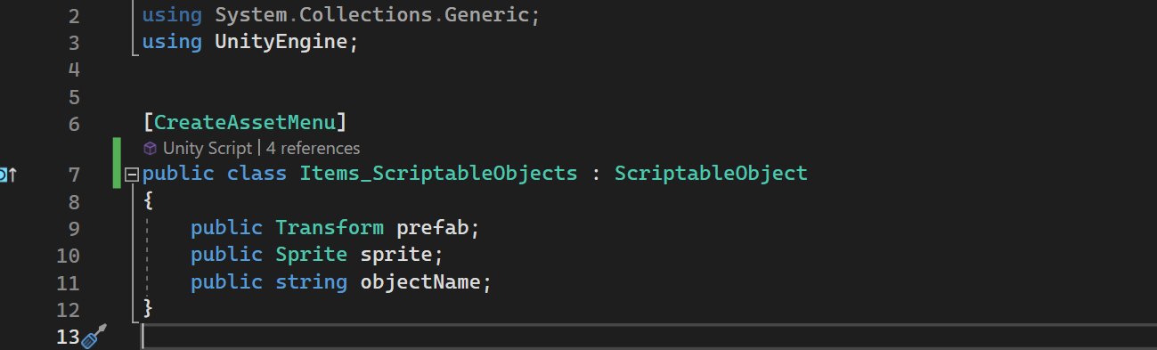
Basic Structure
-And any extra information as you needed!

Slide 5


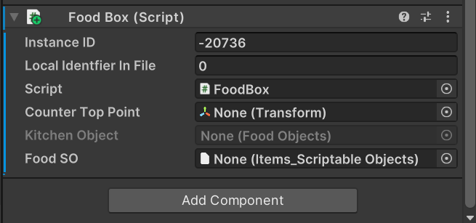
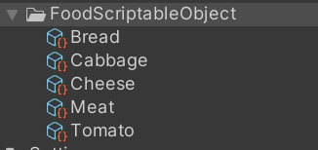
How It works
Game Object
What you wanna create ?
- Set scriptable object
Where you wanna create?
- Set C# script in the game object
What you wanna do with the created object?
- Write game logic in C# script

Slide 6
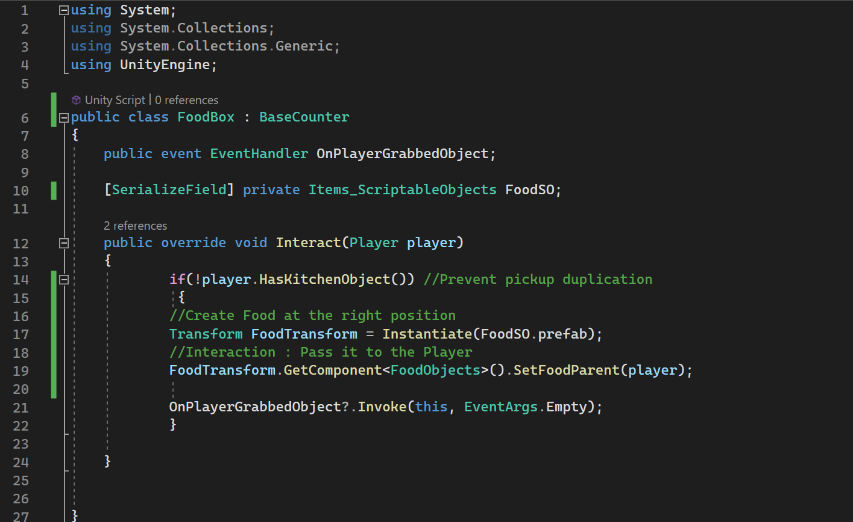
Example of Scriptable Object Usage
When interact, create the food item.

Slide 7
Data Types
Unity Object Types:
GameObject
Material
Texture2D
Sprite
AudioClip
AnimationClip
Mesh
Shader
Primitive Data Types:
int
float
double
bool
char
string
Unity Types:
Vector2
Vector3
Vector4
Quaternion
Color
Notes:
그 외에도 Array, Enum 등등 무궁무진함.

Slide 8
Scriptable Object vs JSON
Scriptable Object
- Support all datatypes in C# and Unity
- Flexible to use
JSON
- Support basic datatypes
- Text Based
- Useful for Save & Load
- Useful for large projects
- Manage data in excel

Slide 9
Pros
Event Handling : Make it easy to work with events happening in some conditions. Easy to track changes.
Memory Efficiency : Scriptable Object don’t need to be attached to Game Object. It reference the memory rather than copying which reduce overhead.
Immutability : The data doesn’t change nor reset the value.
Notes:
메모리 효율성: Scene이 변경되어도 데이터가 유지되므로, 메모리 사용이 효율적입니다.
재사용성: 동일한 데이터를 여러 게임 오브젝트에서 재사용할 수 있습니다.
확장성: 데이터 구조를 쉽게 확장하고 수정할 수 있습니다.
디커플링(Decoupling):
이벤트 발생 소스와 이벤트를 처리하는 리스너 사이의 종속성을 줄일 수 있습니다.
이로 인해 코드의 모듈성과 재사용성이 향상됩니다.
유연성:
스크립터블 오브젝트를 이용한 이벤트 시스템은 유연하게 확장 및 수정이 가능합니다.
다양한 이벤트와 리스너를 쉽게 추가하거나 변경할 수 있습니다.
씬 독립성:
스크립터블 오브젝트는 씬에 종속되지 않으므로, 여러 씬에서 동일한 이벤트를 공유하고 처리할 수 있습니다.

Slide 10
Be cautious
Immutability : The data doesn’t change nor reset the value. So use the data that the value doesn’t change throughout the game. (It’s not used for player character! )
Notes:
메모리 효율성: Scene이 변경되어도 데이터가 유지되므로, 메모리 사용이 효율적입니다.
재사용성: 동일한 데이터를 여러 게임 오브젝트에서 재사용할 수 있습니다.
확장성: 데이터 구조를 쉽게 확장하고 수정할 수 있습니다.

